Slide 1
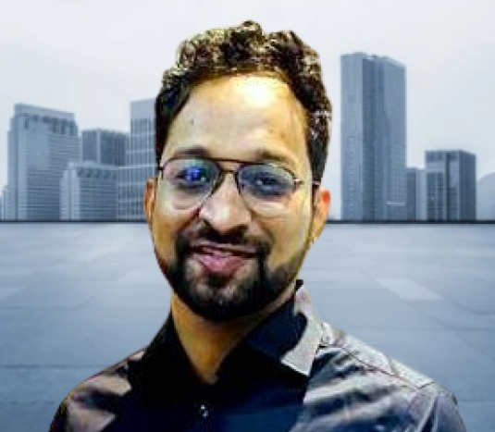
Sunith Kumar Merugu
Profile for Young Guns FY’23

Slide 2
Sunith Merugu
Technical Lead
Hyderabad, India
ABOUT ME
+91-8333005006
6 yrs experienced in IT industry and skilled as CRM Consultant in work with Dev, Test and Prod Environment.
Substantial exporsure towards CRM configurations working with Product Group of Microsoft.
sunithmerugu22@gmail.com
LANGUAGES
EDUCATION
English
2007 - 2011
100%
Bachelor in Technology Computer Science Eng. Lords Inst. Of Eng.& Technology, JNTU-H
Hindi
Had a great exposure towards computer geeks during early phase of college life
100%
Telugu
2012- 2014
100%
SKILLS
Information Assurance & Security (IAS) , Wellington Institute of Technology – New Zealand
CRM D365 Consultant
Opportunity to understand&importance of cyber security with various ethnicity
Teamwork
WORK EXPERIENCE
Work Ethics
2015 - 2022
ACHIEVEMENTS
Birlasoft Pvt. Ltd., Technical Lead Sonata Software Pvt. Ltd., Sr. CRM Analyst Handssys Software Pvt. Ltd., Software Engineer
Power BI/CRM certificate
Customer’s Delight

